Slide 1

Capstone Project
NAME:ABU SHALAK RUHAN ID-221-35-835
Submit to: Md. Julkar Nayeen Mahi

Slide 2

PROJECT PLAN
Overview
My project on about an online bus ticket service.
Objectives
Goals
View of Route.
operator selecting.
Seat choosing.
Reduce complexity.
Buy Ticket from home.
Time save.
03

Slide 3
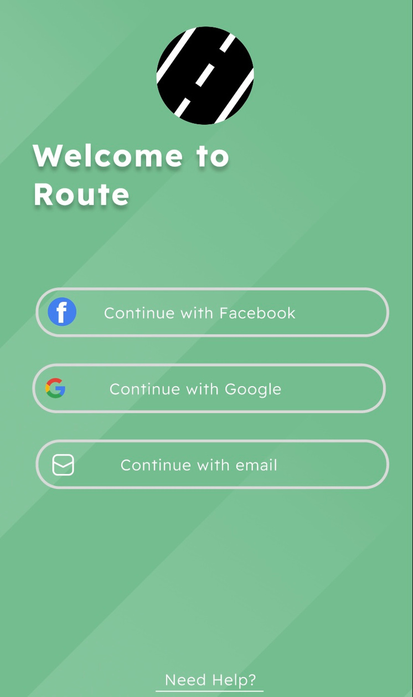
PROJECT PLAN
Feature
Welcoming page
user can log in with Facebook or Gmail.
03

Slide 4
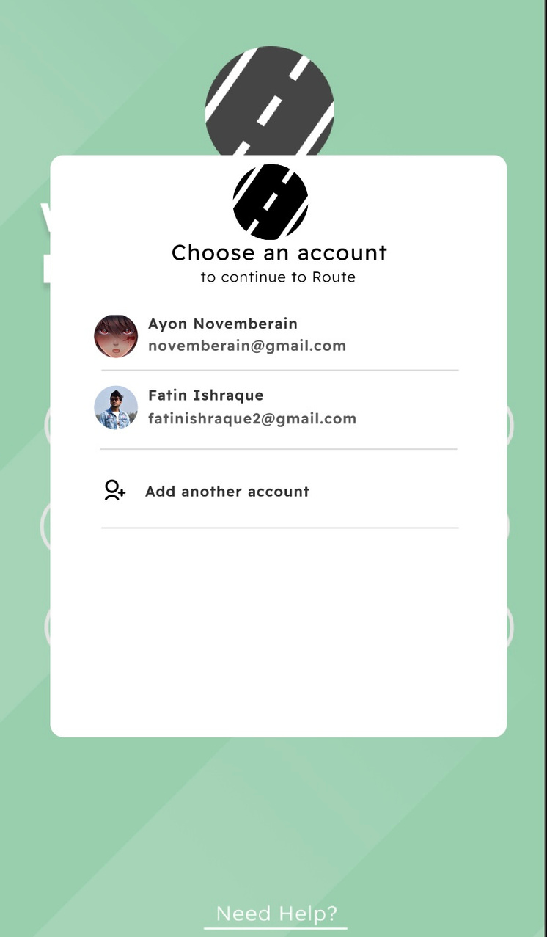
PROJECT PLAN
Feature
Selecting Gmail.
03

Slide 5
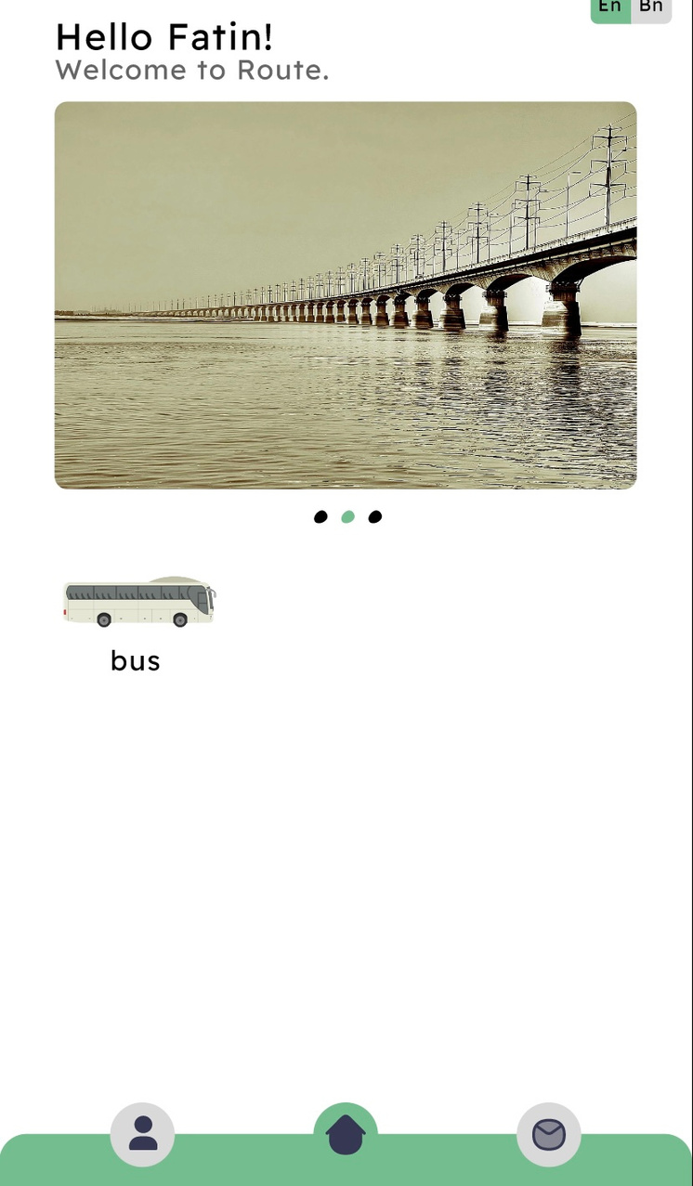
PROJECT PLAN
Feature
This is the Home page of my app.
Here we have bus operator option.
03

Slide 6
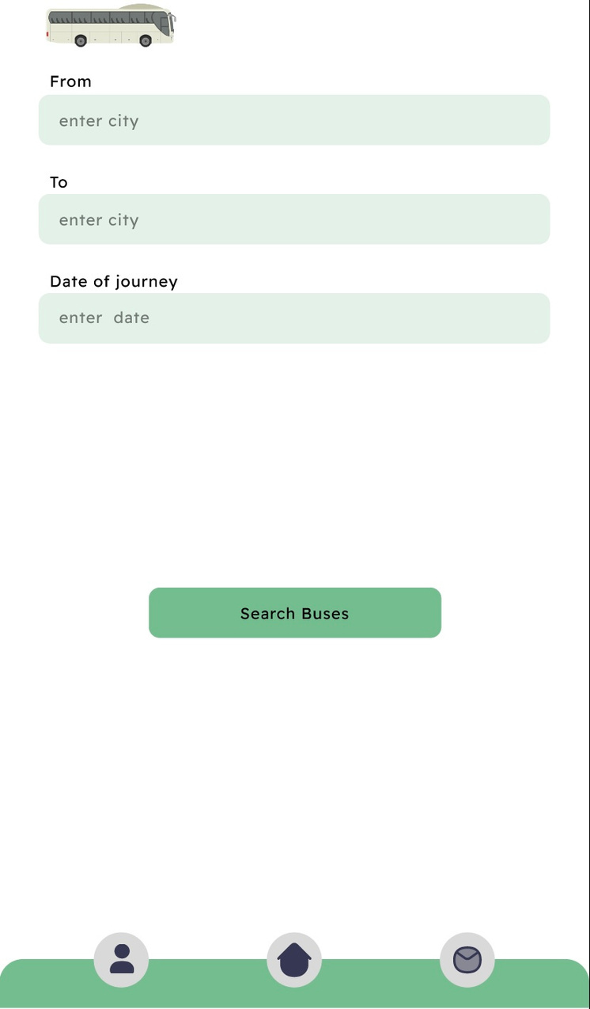
PROJECT PLAN
Feature
After choosing bus option, user can search
their require Route and Buses.
03

Slide 7
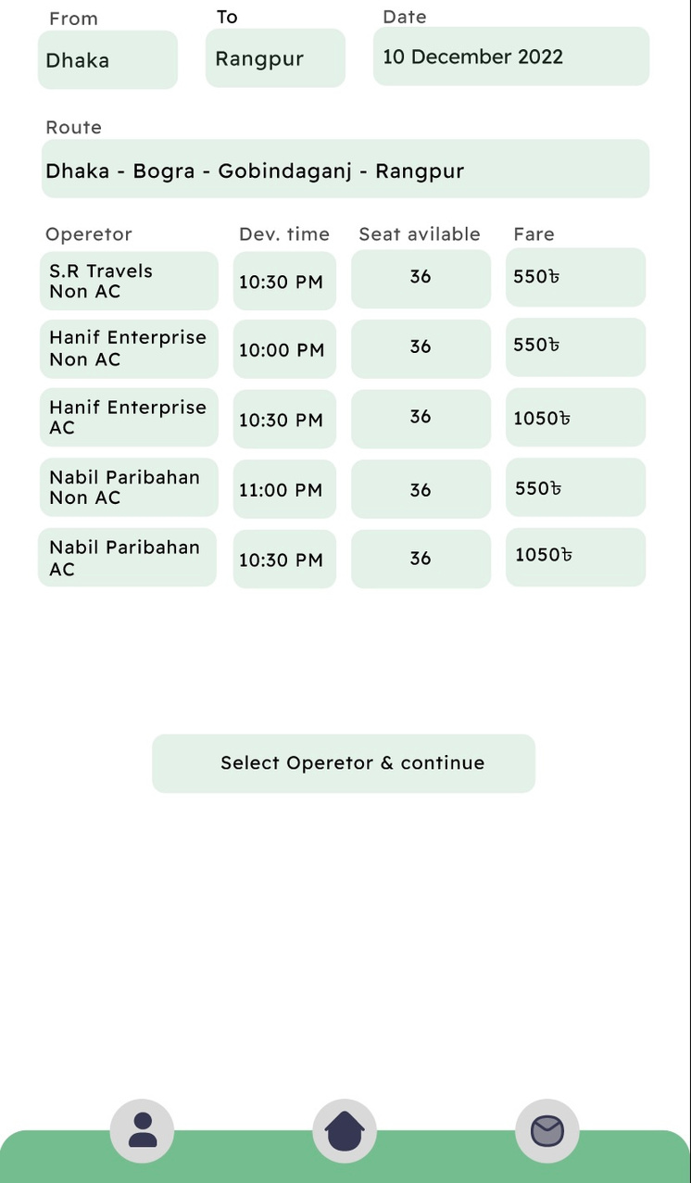
PROJECT PLAN
Feature
After searching the app will show to user available buses with time, seat, fare on the required route.
03

Slide 8
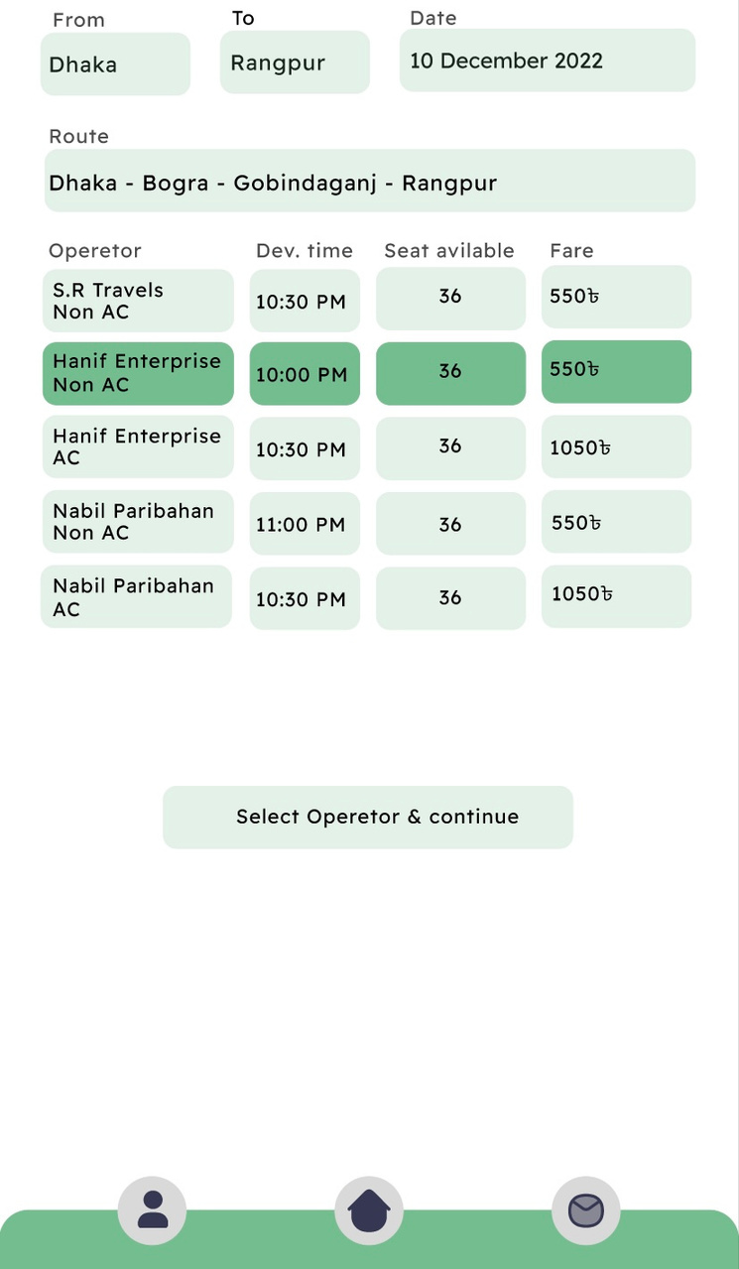
PROJECT PLAN
Feature
Then user can select their preferable operator.
03

Slide 9
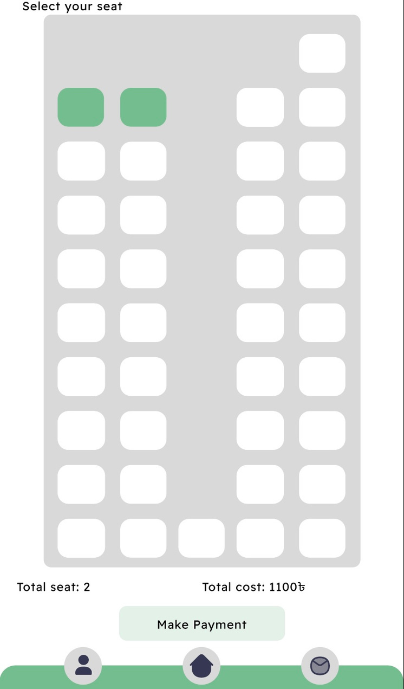
PROJECT PLAN
Feature
Then user can choose their seats .After that
they will go forward to make payment .
03

Slide 10
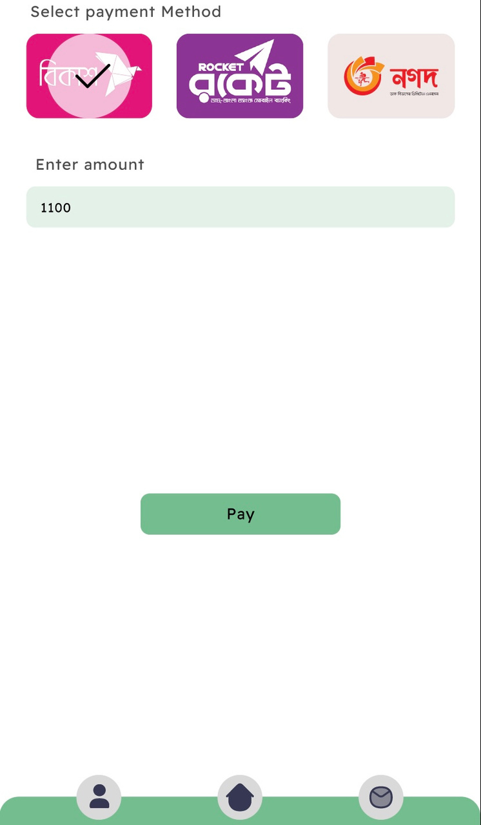
PROJECT PLAN
Feature
Then user will pay the fare.
03

Slide 11
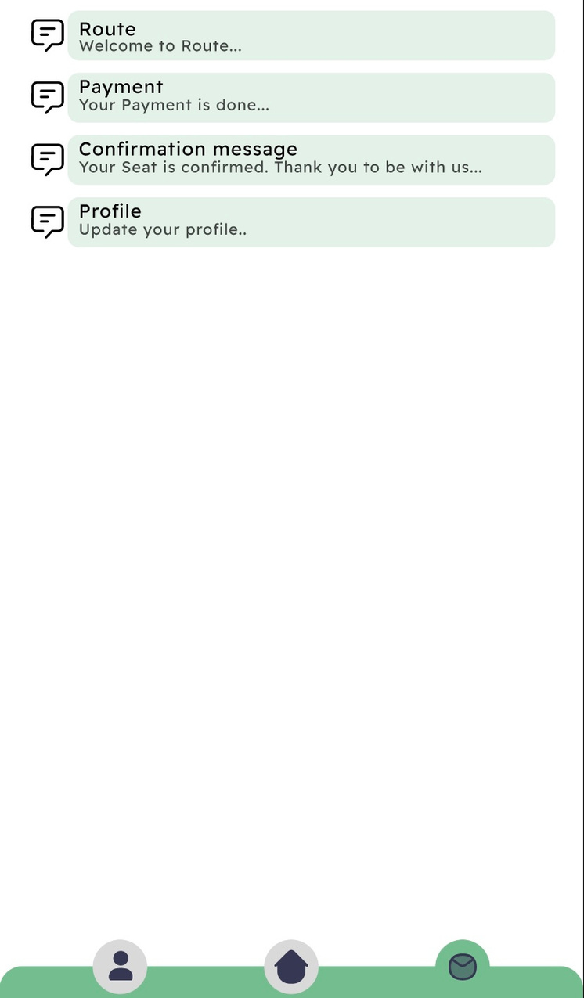
PROJECT PLAN
Feature
After payment user gets the confirmation
massage from the app .
03

Slide 12
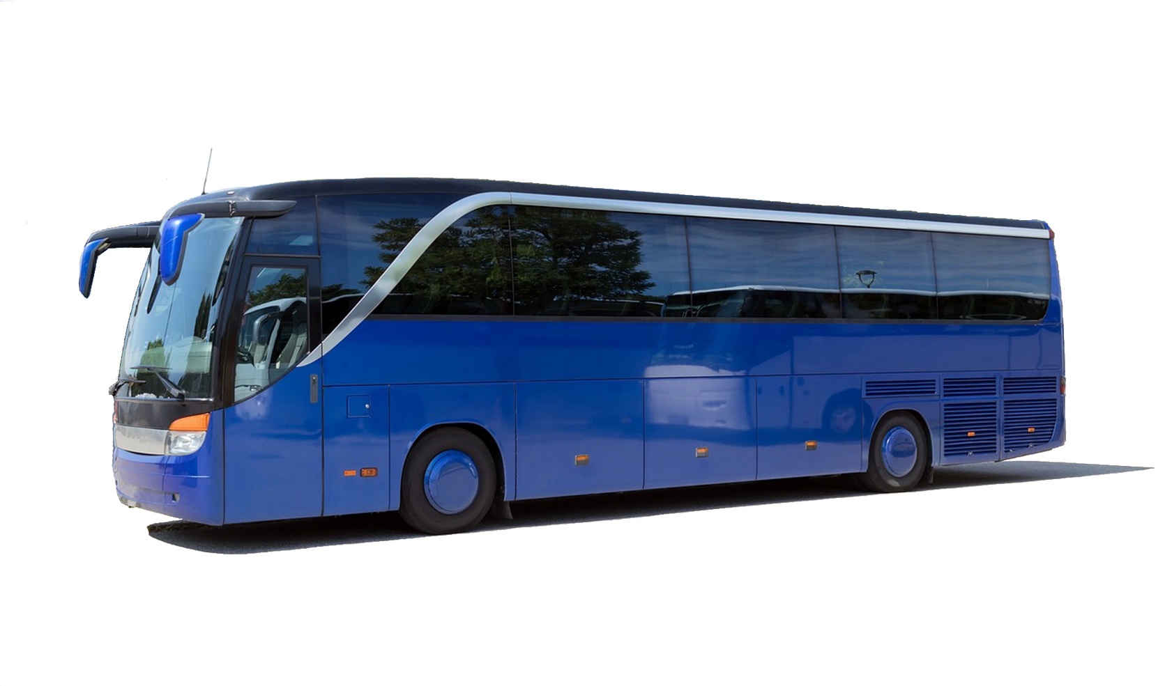
Have a safe journey , Thank You.

